Slide 1
Civil Rights Timeline

Slide 2
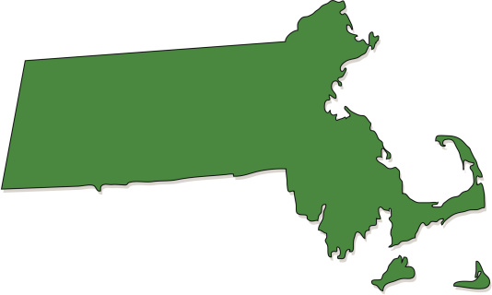
1783 – Massachusetts outlaws slavery within its borders.

Slide 3
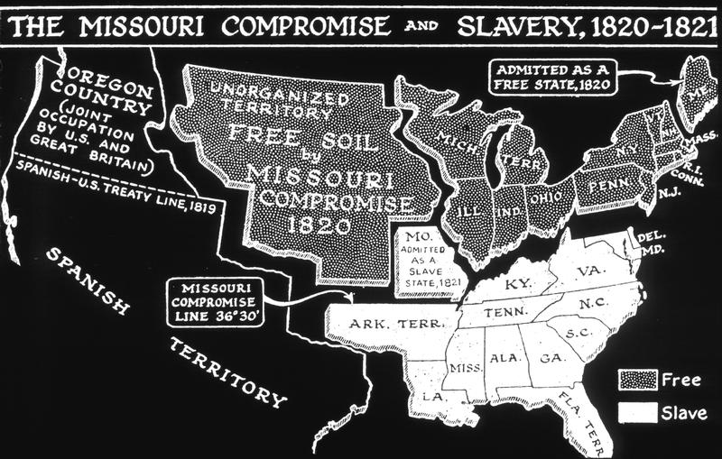
1820 – Missouri Compromise is reached to maintain a balance of 12 slave states and 12 free states.

Slide 4
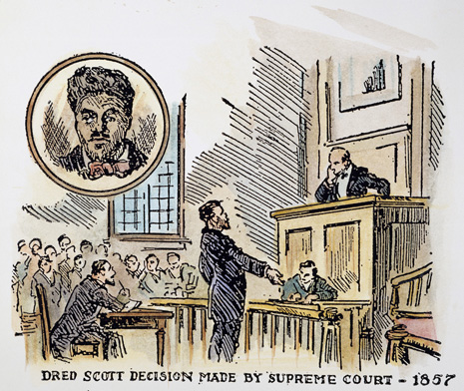
1857 – The Dred Scott Decision: the Supreme Court rules that slaves do not become free when they are in a freed state and that blacks cannot become citizens.

Slide 5
1861 – The South secedes from the Union, starting the Civil War.

Slide 6
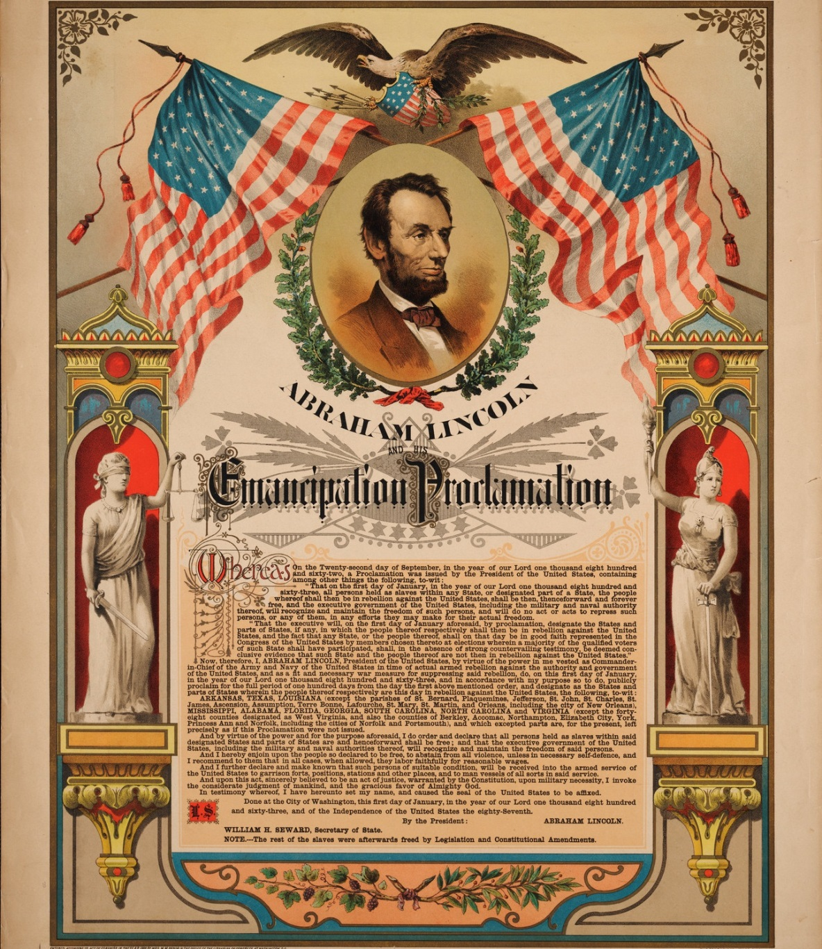
1863 – President Lincoln issues the Emancipation Proclamation that frees “all slaves in areas still in rebellion”.

Slide 7
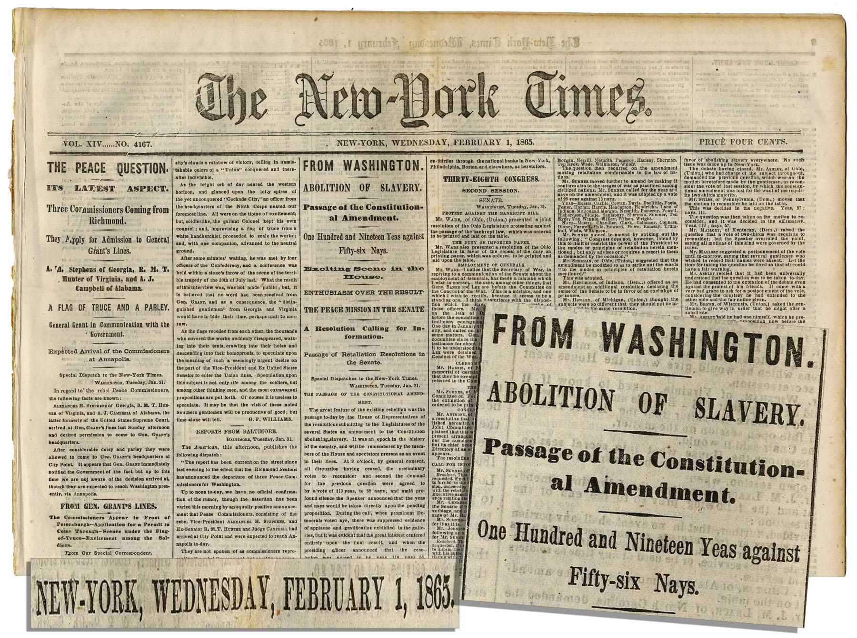
1865 – The Civil War ends and the 13th Amendment abolishes slavery.

Slide 8
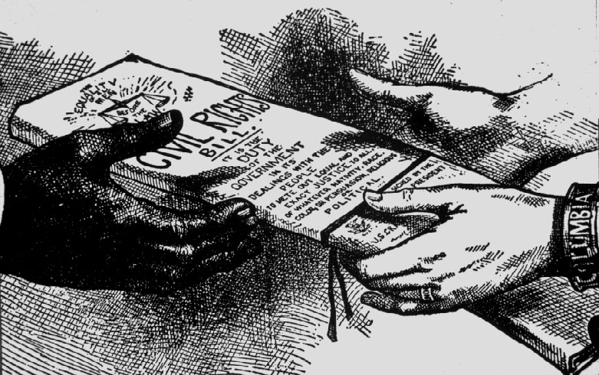
1868 – The 14th Amendment: everyone has equal protection under the law.

Slide 9
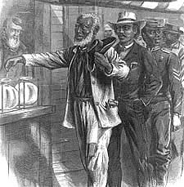
1870 – 15th Amendment: racial discrimination in voting is banned

Slide 10
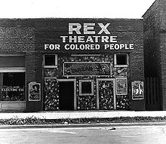
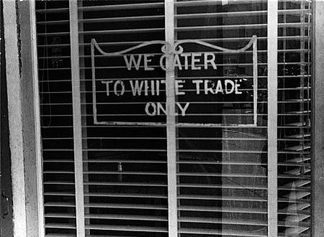
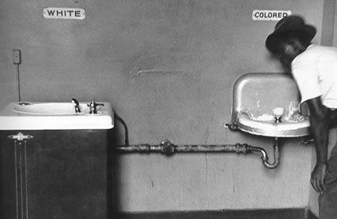
1896 – Supreme Court approves the “separate but equal” segregation

Slide 11
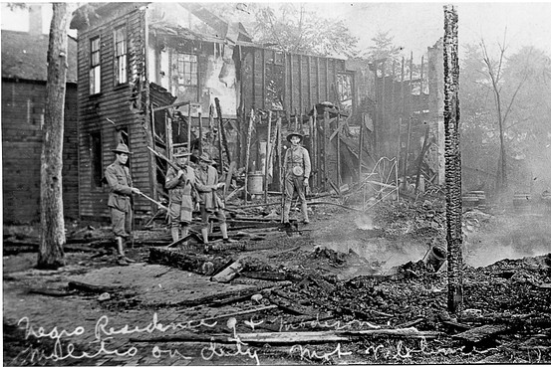
1909 – NAACP is formed in response to lynchings and a horrific riot in Springfield, Illinois.

Slide 12
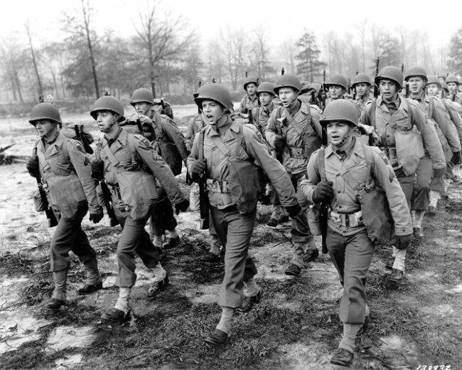
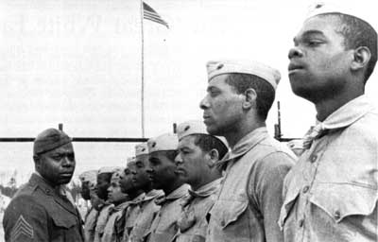
1939-1945 - WWII

Slide 13
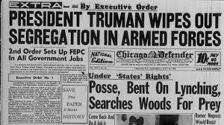
1948 – military segregation ends

Slide 14
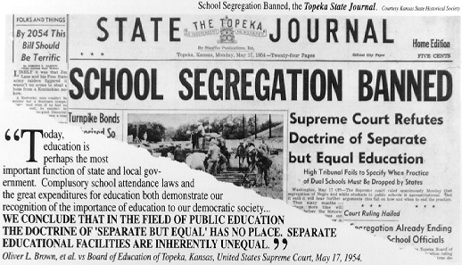
1954 – Brown vs. Board of Education of Topeka: Supreme Court rules school segregation is unconstitutional

Slide 15
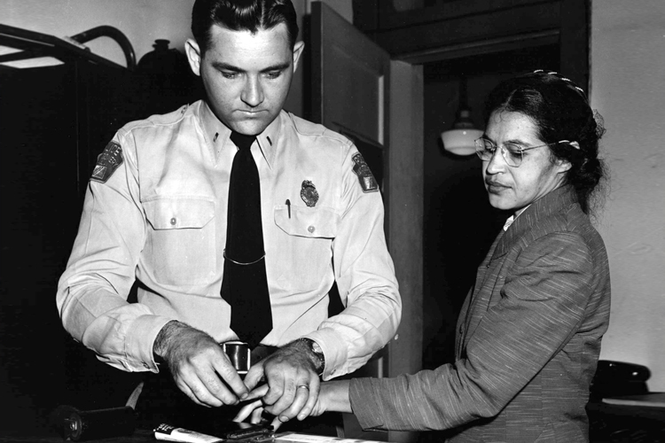
1955 – Rosa Parks refuses to move to the back of a Montgomery, Alabama bus and is arrested, which leads to bus segregation being declared unconstitutional.

Slide 16
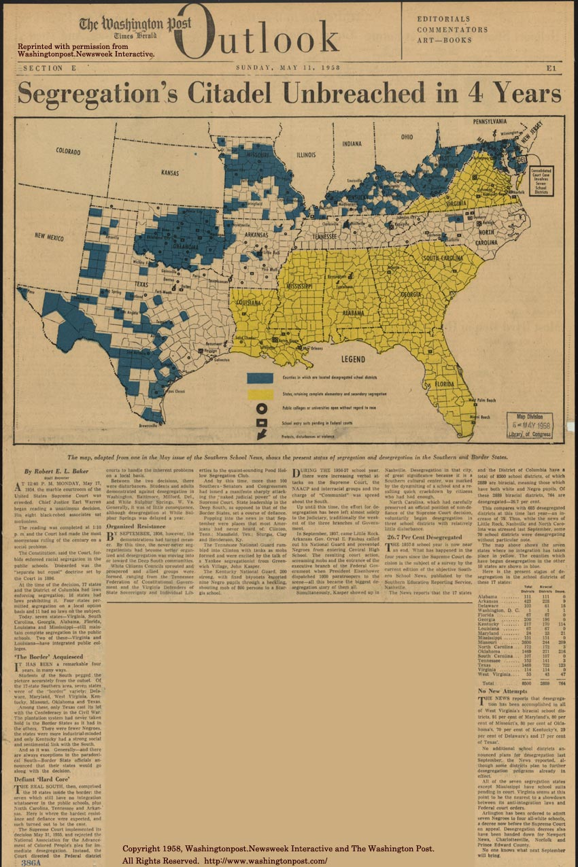
Notes:
Yellow – complete segregation Blue – counties that have desegregated schools Not sure about white?
Circle – colleges open regardless of race Square – schools (not sure the middle) in federal court Arrow – protests, disturbances, or violence
http://www.loc.gov/exhibits/brown/images/br0140.jpg

Slide 17
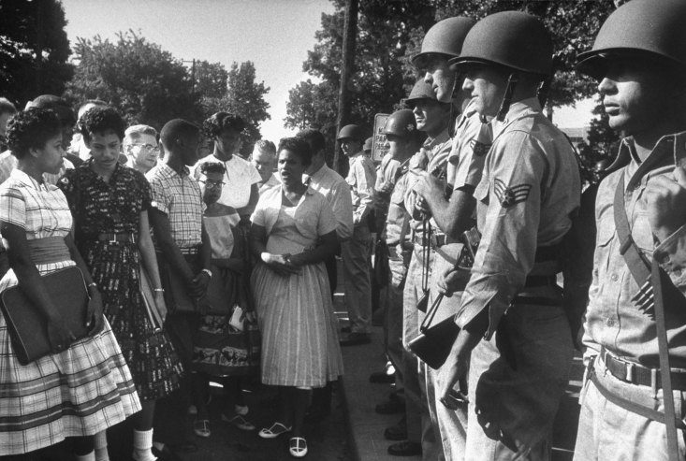
1957 – The Arkansas Governor uses the National Guard to block nine black students from attending Little Rock High School. President Eisenhower sends in the army to allow the students to enter the school.
Notes:
1st day Little Rock 9 try to go to school, National Guard blocks them from entering and they have to go home.

Slide 18
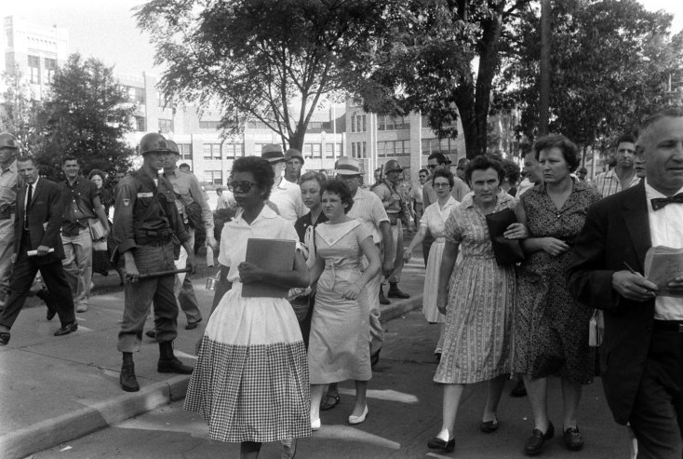

Slide 19
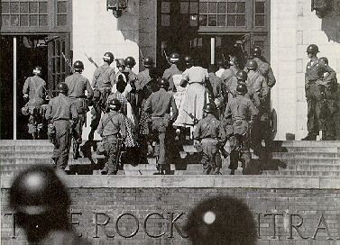
Notes:
LR9 being escorted into school by the army.

Slide 20
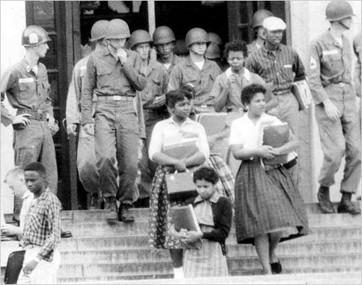
Notes:
Leaving school with military escort.

Slide 21
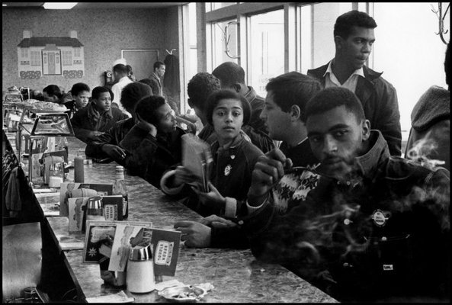
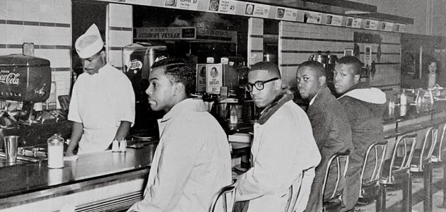
1960 – College students start a sit in at a lunch counter in Greensboro, NC where black patrons are not served.

Slide 22
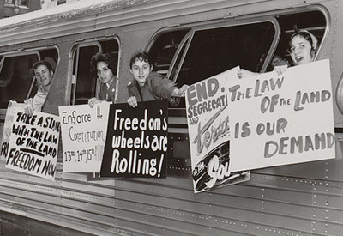
May 4, 1961 – The first of the Freedom Rides begin from Washington D.C. into the South to test new laws that prohibit segregation.

Slide 23
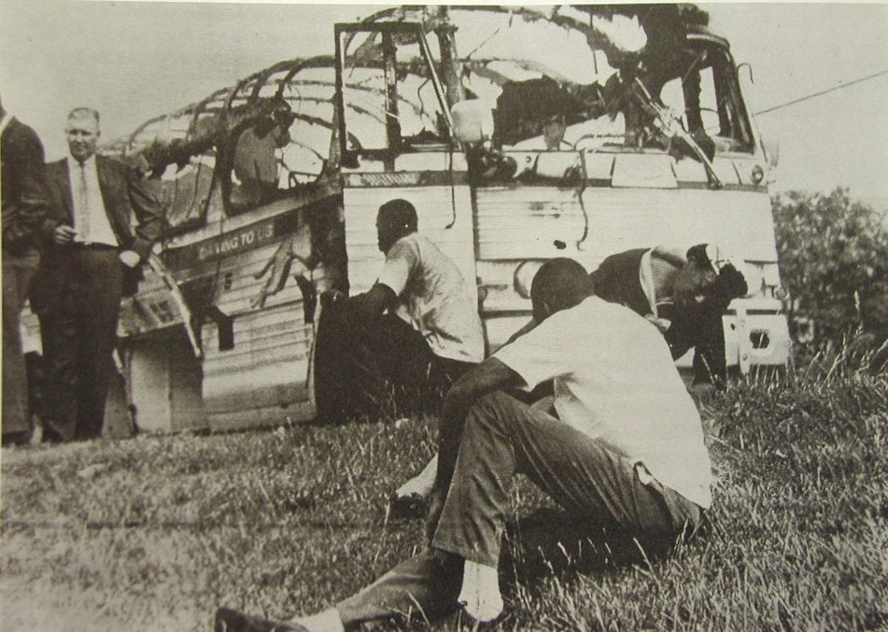
Notes:
Aftermath of a Freedom Riders bus that was burned, passengers suffered mild injuries including some minor burns and smoke inhalation.

Slide 24
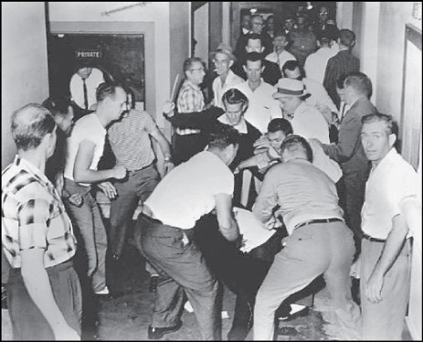
Notes:
A Freedom Rider is attacked by a mob.

Slide 25
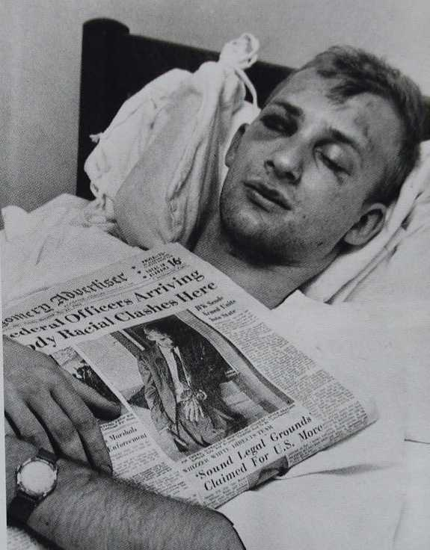
Notes:
Freedom Rider in the hospital with the newspaper story of his attack.

Slide 26
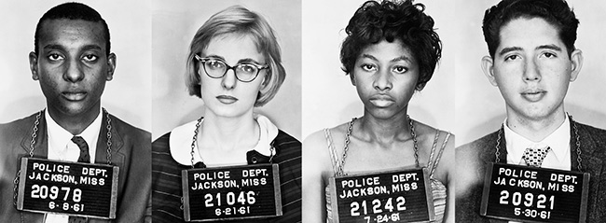
Notes:
Arrested Freedom Riders

Slide 27
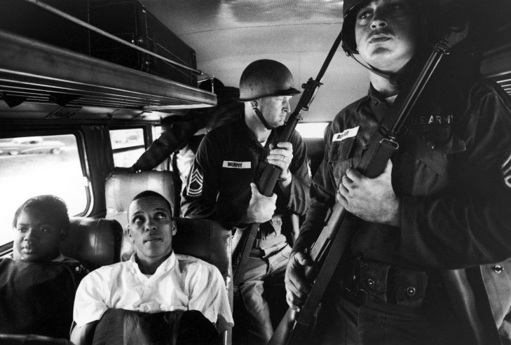
Notes:
National Guard (I think) was sent to ride with the Freedom Riders to protect them

Slide 28
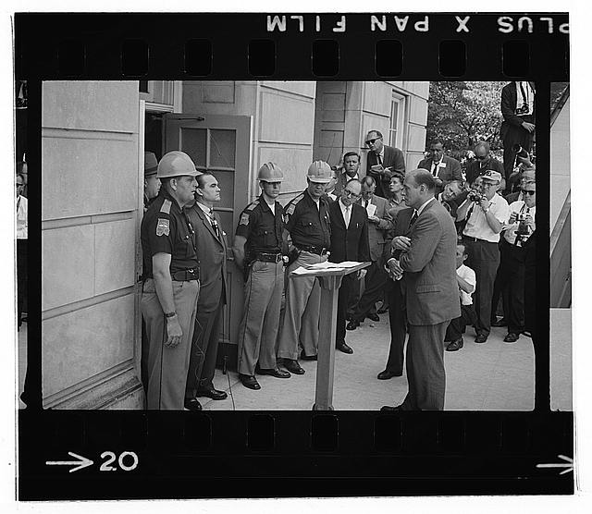
June 11, 1963 – Alabama Governor George Wallace blocks two African American students from registering at the University of Alabama.
Notes:
This was to fulfill a campaign promise he made.

Slide 29
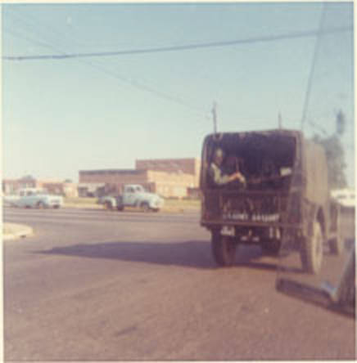
President Kennedy sent in the National Guard to ensure that the students were able to register.
Notes:
Kennedy sent in the National Guard. Governor gave up when they showed up. Kennedy’s address was in response to him having to send in the National Guard to enforce national law.

Slide 30
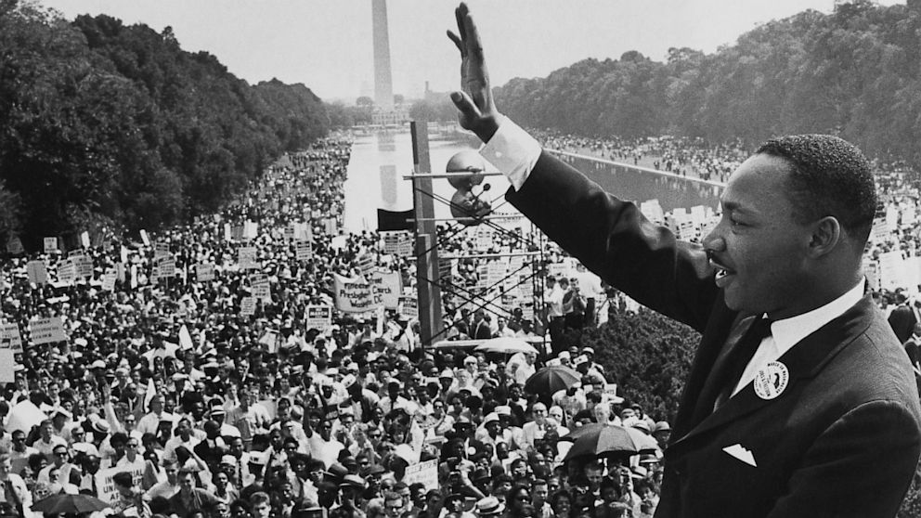
1963 – Dr. Martin Luther King, Jr. delivers his “I Have a Dream” speech at the March on Washington, D.C.

Slide 31
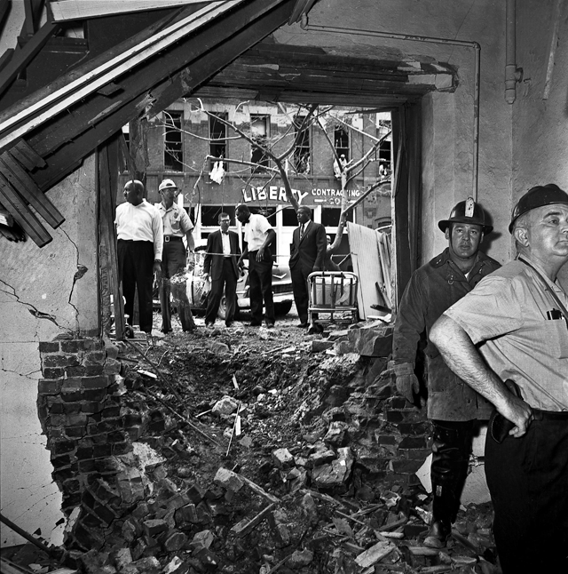
1963 – An Alabama African American church was bombed by KKK members who were protesting integration, killing four little girls.
Notes:
Girls were ages 14 (3) and 11

Slide 32
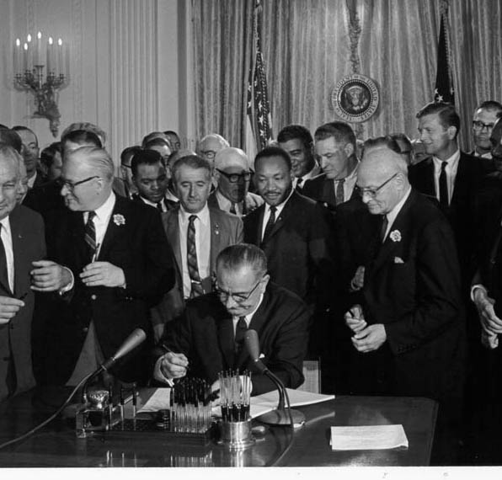
1964 – The Civil Rights Act outlaws major discrimination against racial, ethnic, national, and religious minorities, and women.

